Slide 1
COMPUTER GRAPHICS AND MULTIMEDIA
CS3CO24

Slide 2
SYLLABUS
Unit-I
Introduction to Raster Scan Displays, Pixels, Frame Buffer, Vector & Character Generation, Random Scan Systems, Display Devices, Scan Conversion Techniques, Line Drawing: Simple DDA, Bresenham’s Algorithm, Circle Drawing Algorithms: Midpoint Circle Drawing and Bresenham’s Algorithm, Polygon Fill Algorithm: Boundary-Fill and Flood-Fill Algorithms.
Unit-II
2-D Transformation: Translation, Rotation, Scaling, Shearing, Reflection. Inverse Transformation, Homogenous Coordinate System, Matrices Transformation, Composite Transformation. Windowing & Clipping: World Coordinate System, Screen Coordinate System, Viewing Transformation, Line Clipping & Polygon Clipping Algorithms.

Slide 3
Unit-III
3-D Transformations: Translation, Rotation and Scaling. Parallel & Perspective Projection: Types of Parallel & Perspective Projection, Hidden Surface Elimination: Depth Comparison, Back Face Detection Algorithm, Painter’s Algorithm, and Z-Buffer Algorithm.
Unit-IV
Curve Generation, Bezier and B-spline Methods. Basic Illumination Model: Diffuse Reflection, Specular Reflection, Phong Shading, Gouraud Shading, Ray Tracing, Color Models like RGB, YIQ, CMY, HSV.

Slide 4
Unit V
Multimedia: Characteristics of a Multimedia Presentation, Multimedia Architecture, Text –Types, Unicode Standard, Text File Formats, Audio- Components of an Audio System, Digital Audio, Digital Audio Processing, Audio File Formats, Video- Digital Video, Digital Video Processing, Video File Formats.
Animation: Uses of Animation, Principles of Animation, 3D Animation, Animation File Formats, Animation Software, MPEG Standards.
Text Book
1. Donald Hearn and M.P. Becker Computer Graphics Pearson Pub.
2. Vaughan, Tay. Multimedia: Making it work. Tata McGraw-Hill Education.
References
1. Parekh, Principles of Multimedia, Tata McGraw Hill.
2. Rogers, "Procedural Elements of Computer Graphics", Tata McGraw Hill.
3. Maurya, Computer Graphics with Virtual Reality System, Wiley India.

Slide 5
What’s this course all about?
We will cover…
Graphics programming and algorithms
Graphics Colour
Applied geometry, modelling and rendering

Slide 6
UNIT 1
Introduction to Raster Scan Displays, Pixels, Frame Buffer, Vector & Character Generation, Random Scan Systems, Display Devices, Scan Conversion Techniques, Line Drawing: Simple DDA, Bresenham’s Algorithm, Circle Drawing Algorithms: Midpoint Circle Drawing and Bresenham’s Algorithm, Polygon Fill Algorithm: Boundary-Fill and Flood-Fill Algorithms.

Slide 7
starting with a simple question
What We Do With Computers?

Slide 8

Document processing

Slide 9
Document processing
Creation/ presentation of documents.
Primary components are the (alphanumeric) characters.
Entered using a keyboard(physical/virtual).
Other components- menu options, editing tools, icons on top.

Slide 10

There is mix of characters and images

Slide 11
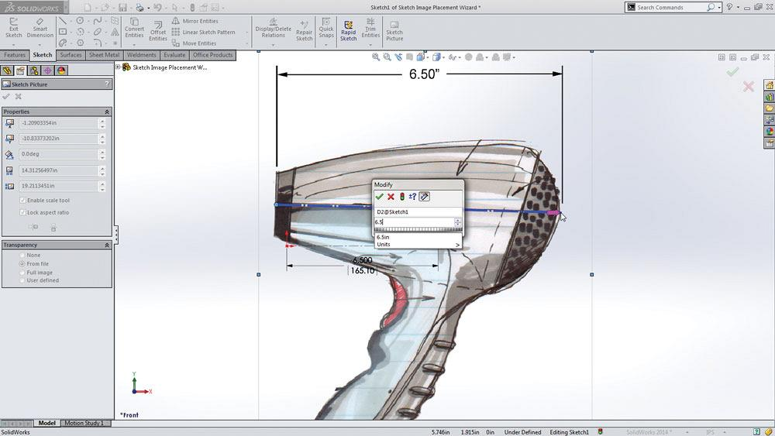
Cad(computer aided design) Interface
Shows design of some machinery parts on screen along with some controls buttons on the right/left hand side.

Slide 12
Cad(computer aided design) Interface
An engineer can specify properties of individual components and try to assemble them virtually on the computer screen to check if there is any problem in the specification.
Saves time, effort and cost, as no need to develop physical prototype and perform checks.

Slide 13
In above examples
What is Common??

Slide 14
What is common
Document Processing
Create/edit/view a document.
CAD
Geometric Shapes( characters and icons) with colors assigned to them.

Slide 15
What is common
How a computer can do all these stuff, all these things
Images consisting of components then we need to put them together into the form of image and we should allow the user to interact with those components or the whole image through input devices as well as we should be able to create the perception of motion by moving those images.

Slide 16
There are two questions
How a we can represent such objects in a language that the computer understand and the computer can process.
How we can map from computers language to some thing that we can perceived, so essentially with the computers o/p in 0/1 we will not be able to understand what that means.

Slide 17
We have four questions
How to represent the components
How to synthesize constituents parts to form a complete realistic imagery?
How to interact(how to allow users to manipulate imaginary constituents on scree?)
How to create impression of motion(animation)

Slide 18
Computer graphics gives solution
Ways that make or try to make optimal resource usage for a given platform.
example:- displaying something on mobile phone requires techniques different from displaying on desktop- due to difference in CPU speed, memory capacity and power consumption issues in two platforms.

Slide 19

Introduction
To display a picture of any size on a
computer screen is a difficult process.
Computer graphics are used to simplify
this process. Various algorithms and
techniques are used to generate graphics
In computers.
We have put a great deal of our time to develop how computer images can replicate real-world scenes. We want objects on computers not only to look more real, but also their colors to be more realistic and how different materials appear. We can call it “real synthesis of the image.”

Slide 20
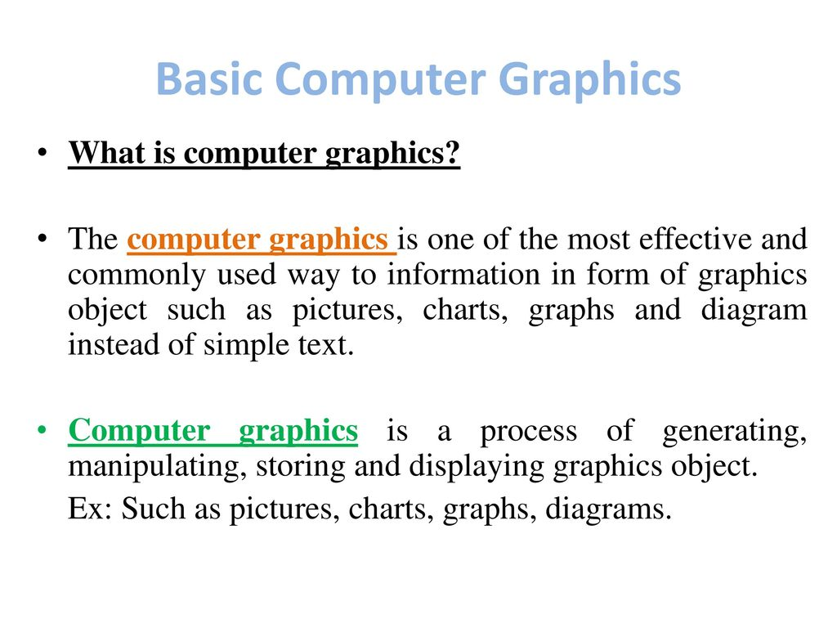

Slide 21
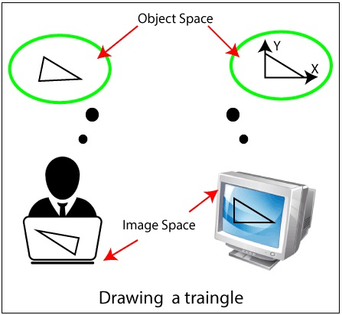
Introduction Cont..
The term computer graphics refer to the following things:
Computer representation and manipulation of image data.
Various technologies for creating and manipulating images.
Computer graphics study is a sub-field of computer science that studies methods for digitally incorporating and manipulating visual content.

Slide 22
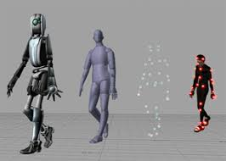
Definition
Graphics is defined as any sketch or a drawing or a special network that pictorially represents some meaningful information. Computer Graphics is used where a set of image needs to be manipulated or the creation of the image in the form of pixels and is drawn on the computer.
“Computer graphics is the use of a computer to define, store, manipulate, interrogate, and represent the pictorial output.” An image in computer graphics is made up of a number of pixels.

Slide 23
History
Computer Graphics (CG) was first developed as a visualization tool. Computer graphics were basically introduced for scientists and engineers in government and corporate research centers, i.e., Bell Labs and Boeing in the 1950s. After then the tools would be developed at Universities in the 60s and 70s at places, i.e., Ohio State University, MIT, University of Utah, Cornell, North Carolina, and the New York Institute of Technology. The computer graphics are invented by researchers Verne Hudson and William Fetter of Boeing. It is often brief as computer graphics.

Slide 24
Importance
The real specificity and importance it’s its interactivity, so that the graphic message is altered enormously by ourselves. From passive spectator we became active modifier of the graphic environment, sometimes even if we don’t know message are shaped around us because choice we made by interacting with the graphic message we see.
Suppose a shoe manufacturing company want to show the sale of shoes for five years. For this vast amount of information is to store. So a lot of time and memory will be needed. This method will be tough to understand by a common man. In this situation graphics is a better alternative. Graphics tools are charts and graphs. Using graphs, data can be represented in pictorial form. A picture can be understood easily just with a single look.

Slide 25
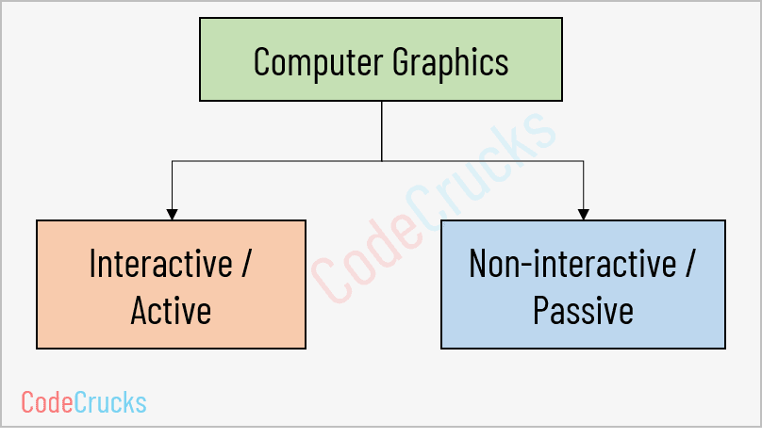
Types of Computer Graphics
There are two kinds of computer graphics are–

Slide 26
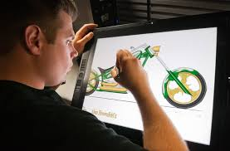
Types Cont..
Interactive Computer Graphics:- In interactive computer graphics, users have some controls over the image, i.e., the user can make any changes to the image produced. Interactive Computer Graphics involves computer-user two-way communication.
For Example:
Drawing on touch screens.

Slide 27
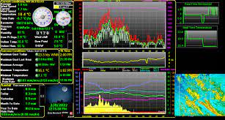


Interactive cg
Display weather forecast or other moving charts/graphs on the screen.
Animating pictures or graphics in movies.
Graphics animation in video games.

Slide 28

Types Cont…
2. Non- Interactive Computer Graphics:- Non-interactive computer graphics are also known as passive computer graphics. It is a type of computer graphics in which the user has no control over the image. The photo is completely controlled by the instructions of the program, not by the user.
For Example:
Screen savers.

Slide 29
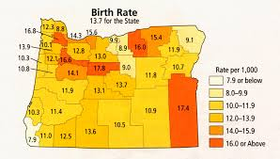
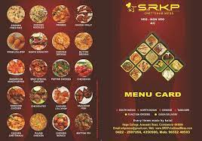
Non-interactive cg
Map representation of the data.
Graphic elements are used in the text, document, and PDF presentation.
Business graphics are used as brochures, business cards, menu of the hotel.

Slide 30
advantages of cg
A high quality graphics displays of personal computer provide one of the most natural means of communicating with a computer.
It has an ability to show moving pictures, and thus it is possible to produce animations with computer graphics.
With computer graphics use can also control the animation by adjusting the speed, the portion of the total scene in view, the geometric relationship of the objects in the scene to one another, the amount of detail shown and so on.

Slide 31
Advantages of Computer graphics
4. The computer graphics also provides facility called update dynamics. With update dynamics it is possible to change the shape, color or other properties of the objects being viewed.
5. With the recent development of digital signal processing (DSP) and audio synthesis chip the interactive graphics can now provide audio feedback along with the graphical feedbacks to make the simulated environment even more realistic.

Slide 32
Disadvantages of Computer graphics:
A majority of complex graphical system applications require prior training before use. Some of the graphics applications are so complex that they need an expert to install and customize the settings.
Like all other computerized systems, graphical system lack the intelligence of understanding real world conditions and principles like the purpose of the structure it is designing.
Most computer-based graphics application change in their technology at a very high rate. This requires one to keep on updating the current software costing a lot of money.

Slide 33
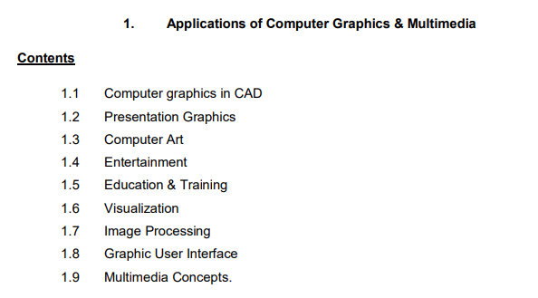

Slide 34
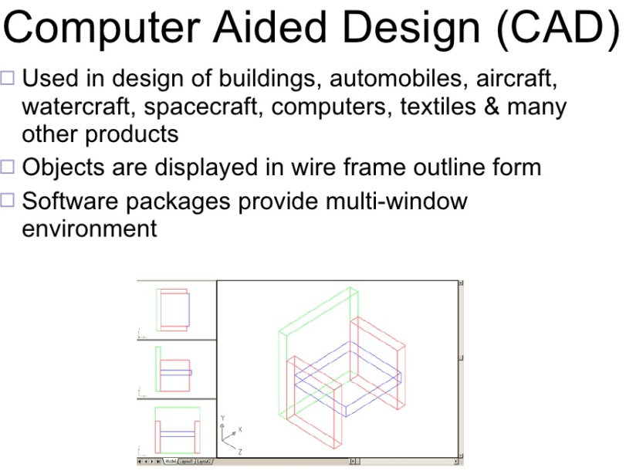

Slide 35
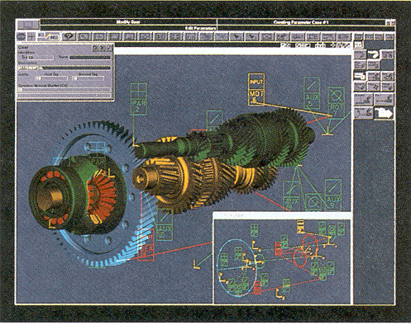

Slide 36
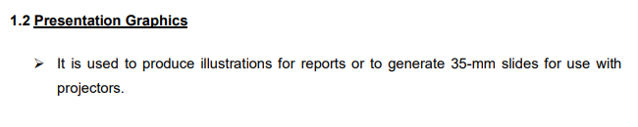
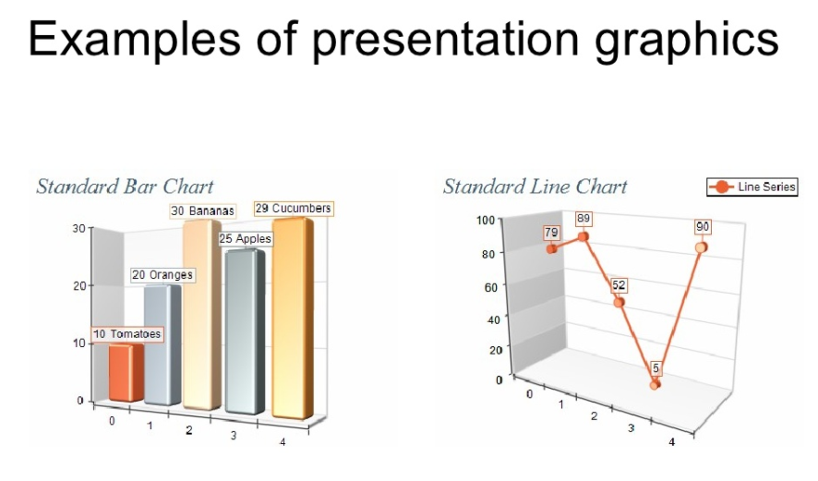
Presentation refers to act of presenting important points of a topic

Slide 37
Computer Art
The ability to create any shape and play with any color that one can imagine through the medium of computer has given the artists a wonderful palate and paintbrush for use of an unlimited canvas

Slide 38
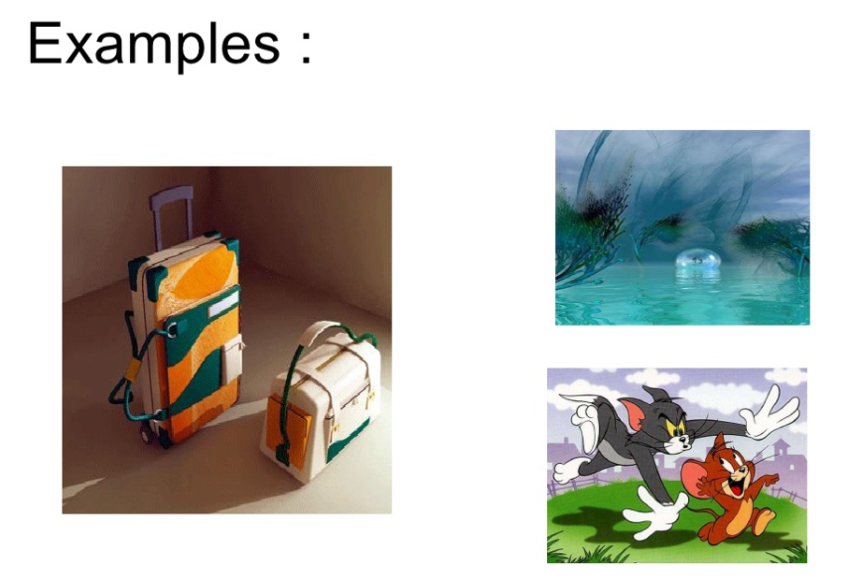
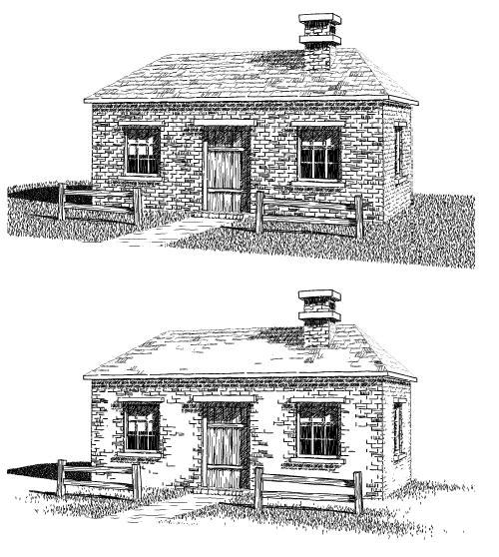

Slide 39
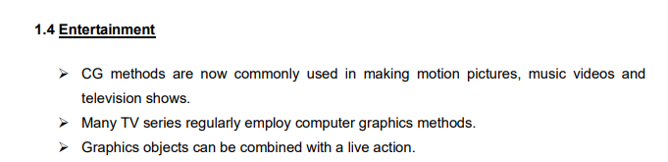

Slide 40
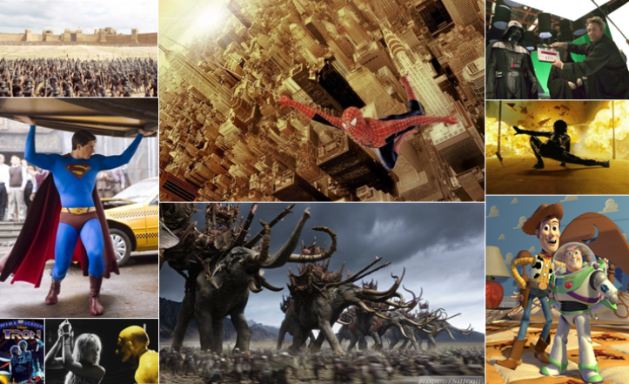

Slide 41


Computer Graphics is about animation (films)‏
Major driving force now

Slide 42
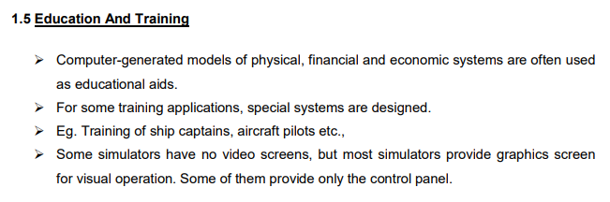

Slide 43
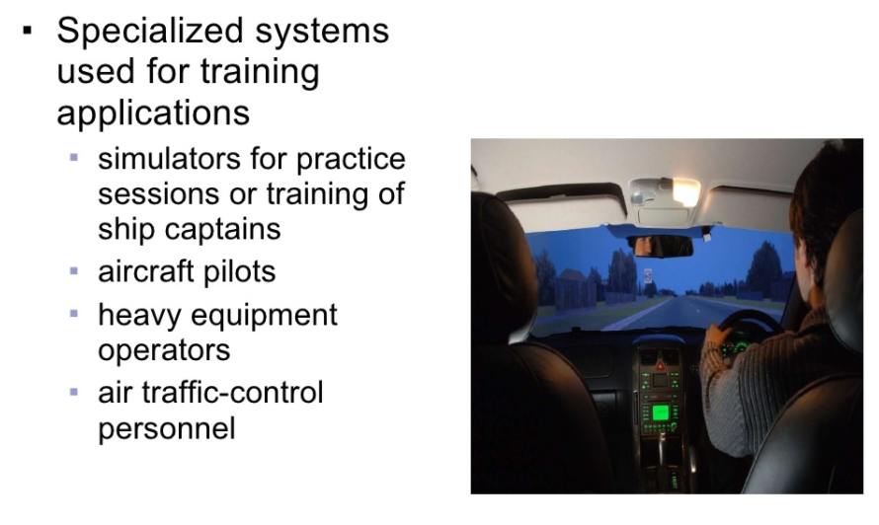

Slide 44
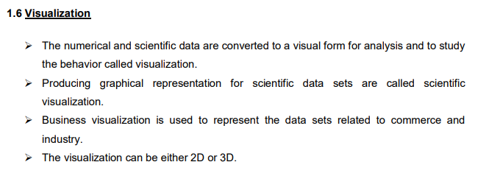

Slide 45
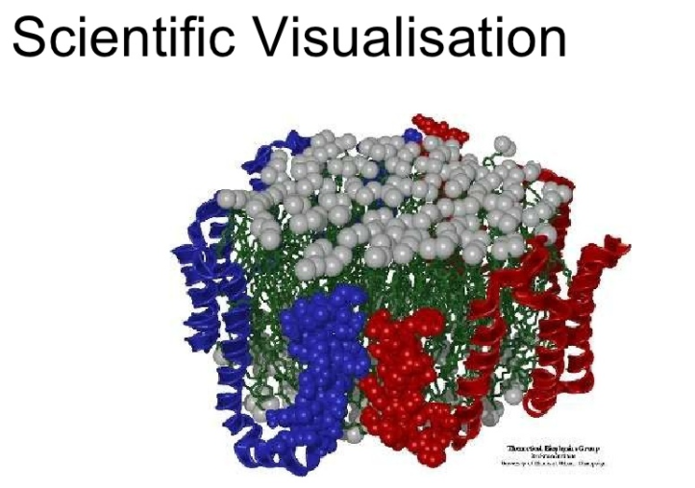

Slide 46
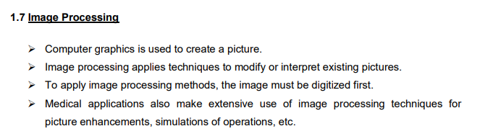
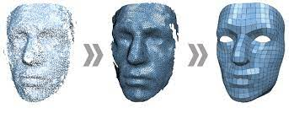

Slide 47
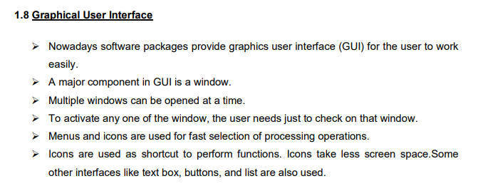

Slide 48
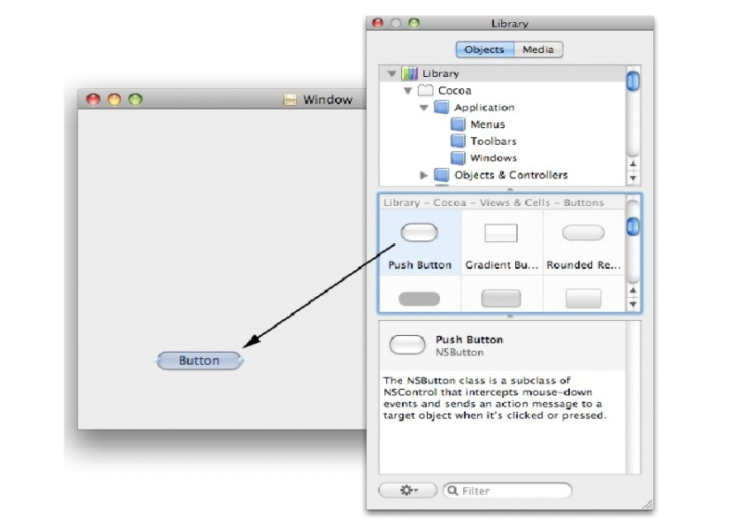

Slide 49

Virtual and augmented reality
Virtual Reality :- The terms 'Virtual' refers to something conceptual that does not have its physical existence, and the word 'reality refers to the state of being real.

Slide 50
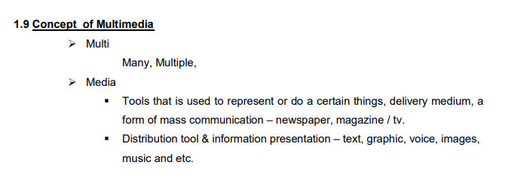

Slide 51


Slide 52
Hardware and Software
of Computer Graphics

Slide 53
Hardware devices
There are two types:-
Input devices
Output devices( Display Devices)

Slide 54
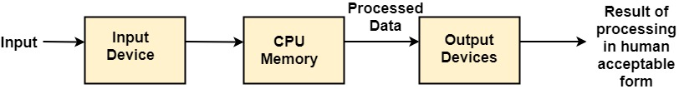
INPUT OUTPUT DEVICES
Input Devices:- An Input device is the piece of computer hardware equipment used to give input to the computer. The input can be in the form of graphics, text, sound, audio, video, and image, etc.

Slide 55
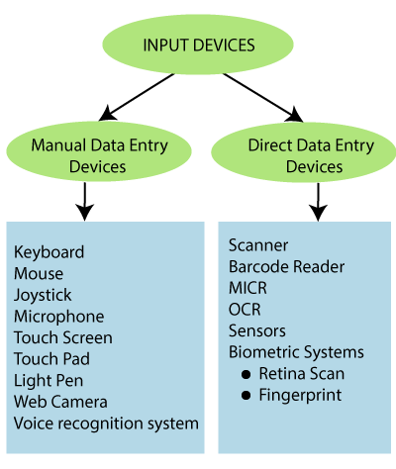
Input Devices cont..
Classification of Input Devices

Slide 56
Input Devices cont..
Keyboard: It is the commonly used input device. It is designed to input text and characters.
A keyboard contains approx. 108 keys. For Example– Alphanumeric keys, Numeric keys, Function key, and cursor key, etc.

Slide 57
Keyboard
Advantages of Keyboards
Easy to use
Enable fast data input
Well tried technology
Disadvantages of Keyboards
Sometimes it is difficult to use
Need desk space to keep

Slide 58

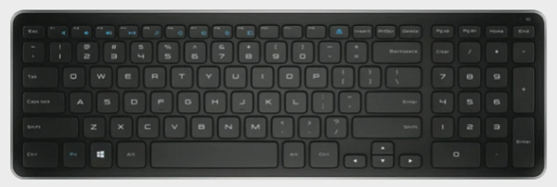
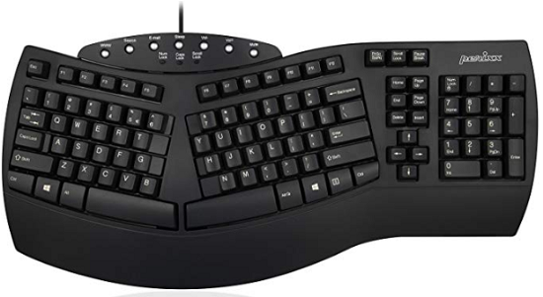
Input Devices cont..
Types of Keyboard: The type of keyboard is:
Normal Keyboard: These are the commonly used keyboard. It is used by the user in their PCs. It contains 108 keys. The normal keyboards are connected to the CPU through the wire.
Wireless Keyboard: The wireless keyboard connected to the computer without the wire. It works for a limited distance. It is more expensive than a normal keyboard. The user faces technical complexity in it.
3. Ergonomic Keyboard: It gives the user comfort and ease during the typing; that’s why it is called the “Ergonomic keyboard.” This keyboard is used to increase the efficiency of the user. It also reduces wrist pain during typing.

Slide 59
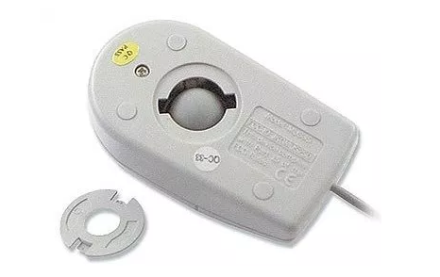
Input Devices cont..
Mouse: It is used as a popular pointing device. It is used to create images, graphics as well as to click on any button or menu. The mouse has two or three buttons.
Functions of the mouse:
Clicking
Double Clicking
Right Clicking
Dragging
Scrolling
1. Mechanical Mouse: This mouse has a rubber ball at the bottom, when we rotate the mouse on the surface than the rubber ball also rotates inside the shell. Now the sensors inside the mouse give a signal to the computer.

Slide 60
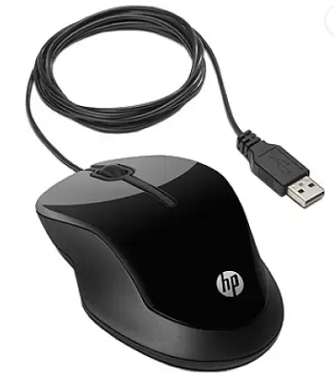
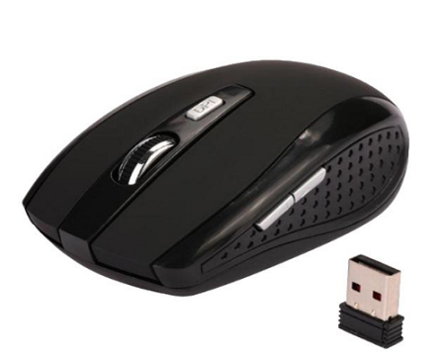
Input Devices cont..
Optical Mouse: It is a type of Non-mechanical mouse. A light beam is emitted from the surface below it. Based on the light beam, the mouse determines the distance and speed of the object.
Wireless Mouse: This mouse communicates to the computer with the help of radio-frequency.
It has two main components:
Transmitter- It is used to send the information of the mouse’s speed and its click in the form of an electromagnetic signal.
Receiver: It connects to the computer and used to receive the signals sent by the transmitter.

Slide 61
Input Devices cont..
Advantages of Mouse
Easy to use.
Less Expensive.
The Cursor moves faster than the arrow keys of the keyboard.
Disadvantages of Mouse
Required flat surface to move
Needs regularly cleaning
Damaged easily

Slide 62
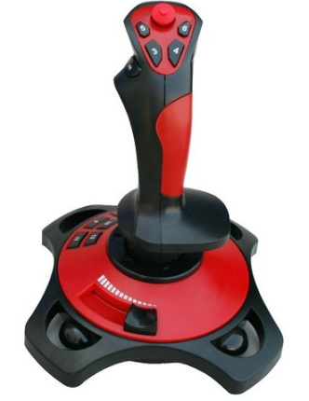
Input Devices cont..
Joystick: which is used to change cursor position on a monitor screen. Joystick is a stick having a spherical ball as its both lower and upper ends. The lower spherical ball moves in a socket. The joystick can be changed in all four directions. The function of a joystick is similar to that of the mouse. It is mainly used in Computer Aided Designing (CAD) and playing computer games.
Advantages of Joystick
Used in playing games
Fast Interface
Easy to Navigate
Disadvantages of Joystick
Sometimes difficult to control
Required hand Movement
It is not robust

Slide 63

Input Devices cont..
Microphone: The microphone was introduced by “Emile Berliner” in 1877. It is also called “Mic.” The Microphone is used to take input in the form of audio.
The microphone is plugged into the specific port of the sound card in the computer system. Some microphones are wireless.

Slide 64
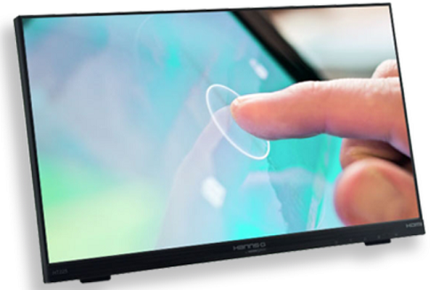
Input Devices cont..
Touch Screen: It is an Electronic Visual Display, which is used to detect the touch of finger and hand in its display area. It is most widely used with those computer machines that can interact with the user.
For Example: Smartphones, Tablet, Etc.
Type of Touch Screen: The types of the touch screen are:
Resistive: It is made up of hardened acrylic plastic. It is pressure sensitive. It has minimal clarity. It has a durability of 15 million touches.
Capacitive: It is made up of glass with coating. It activates by human body electricity. It has the best clarity. It has a durability of 60 million touches.
Surface Acoustic Wave (SAW): It is made up of a Glass with coating. SAW activates by wave absorption. It has medium clarity. It has a durability of 30 million touches.
Advantages of Touch Screen
Simple User Interface
Speed
Improve Accessibility
Disadvantages of Touch Screen
Screen Size
Sensitivity Issue
Accidental Dialing

Slide 65
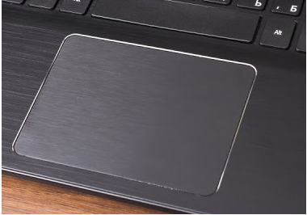
Input Devices cont..
Touch Pad: It is a flat pad used in laptops on which we slide the finger to move the cursor. It is a touch-sensitive area. It is also called “Track pad.” It is used to translate the motion and position of the user’s finger.
It also includes two buttons:
Left Click: It is used to select the option.
Right Click: It is used to display the options on the screen.
Advantages:
No Mouse Needed
No need of a wire-like mouse
Disadvantages:
Lacks of the scroll wheel
Less sensitive than a mouse

Slide 66

Input Devices cont..
Light Pen: It is a tool that is light sensitive. It is used to draw pictures and graphics on the computer screen. It is also used to select the objects.
The pictures made by the light pen can be stored in the computer and can be improved as needed.
Advantages:
It allows the user to select any object.
It does not have any coating.
Easy to Use
Available in different colors
Disadvantages:
Works only with CRT screens
Not very accurate drawing
Sensitive with dust

Slide 67
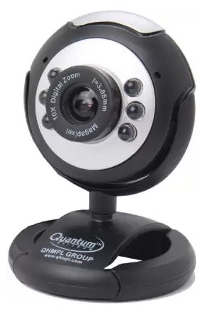
Input Devices cont..
Web Camera: It is a hardware input device. It is a video camera that is used to transmit pictures or videos in real-time to a computer network.
It is connected with laptops, or we can connect it with the computer through USB cable. It is also called a small digital camera.
Advantages:
It can connect with people across the world.
Easy to use
It uses both sound and video
Disadvantages:
Poor Quality Images
Limited Features

Slide 68
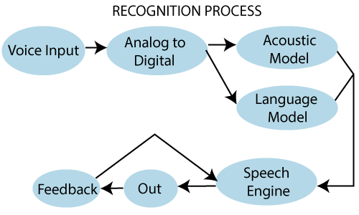
Input Devices cont..
Voice Recognition System: It is also called the “Speech Recognition System.” It is a computer software program that takes human speech as an input, converts that into digital form, and act on it.
Voice recognition system is used to operate mobile phones through voice command.
For Example: Google Assistant, SIRI (Apple) Etc
Advantages:
Improves Efficiency
Easy to use for anyone
Easy to Understand
Disadvantages:
Vocal Problems
Requires more storage to store voice files
Noise Interference

Slide 69
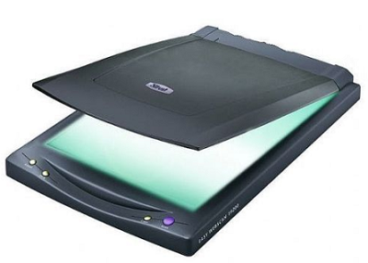
Input Devices cont..
Scanner: It is an input device. It is used to scan documents such as photographs. It is used to input any shape or written data on a page directly into the computer.
Advantages:
High-Resolution Images
Easy to handle
Fast image analysis
Image portability
Disadvantages:
High Cost
The Need for internet and power supply
Difficult to manage large digital files.

Slide 70
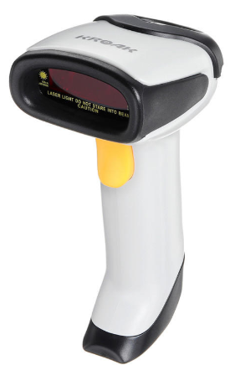
Input Devices cont..
Barcode Reader: It is also known as “Price Scanner” or “Point-of-sale scanner.” A barcode is a particular type of code. It contains a series of thick and thin lines, which are called “Bars.” The bar contains the information.
We can read the barcode through an optical scanner called “Barcode Reader.” The user can connect the barcode reader with the computer through a serial cable.
Advantages:
Fast Speed
Accuracy
Portable
Disadvantages:
Require a clear line of sight
Expensive

Slide 71
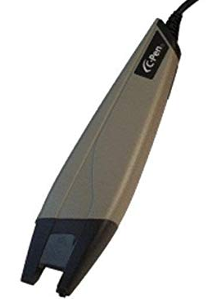
Input Devices cont..
OCR: It is also called “Optical Character Recognition.” It is a technique which is used to read a special type of symbols, letters, or the numbers. The light source can read the characters.
The OCR can read characters printed from typewriters, the character of the cash register, and the character of the credit card. The OCR fonts are stored on the computer.
Advantages:
Faster data entry
Printed document converted into text files
Disadvantages:
Cannot recognize all type of text
Poor or Old documents cannot be recognized

Slide 72
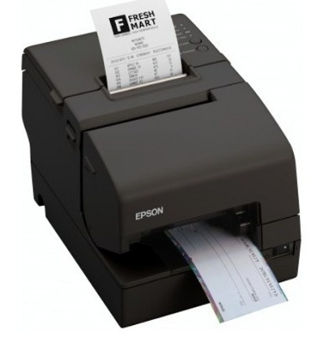
Input Devices cont..
MICR: It is also called “Magnetic Ink Character reader.” It is widely used in the processing of cheques in the bank. MICR is used for reading magnetic ink printed characters.
Advantages:
More secure than OCR
More accurate than OCR
Allow overwrite cheques
Disadvantages:
Only a limited character set
Expensive

Slide 73
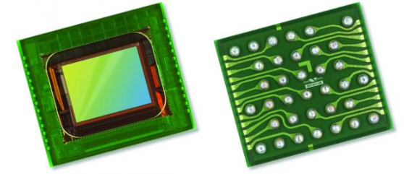
Input Devices cont..
Sensors: A Sensor can be treated as an input device that is used to detect and change the force, pressure, any other physical quantity, and sends the data to the computer.
Advantages of Sensors
Sensitivity
Reliability
High-Resolution
Disadvantages of Sensors
Affected by temperature and humidity
Difficulties in designing

Slide 74
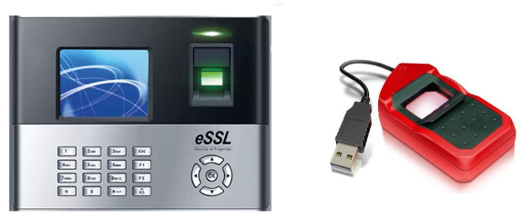
Input Devices cont..
Biometric System: A biometric system is defined as an input system that is used to identify a person. A biometric machine can identify a person by face, eyes, voice, finger, or thumb impression. It is a secure system; it means no biometric data can be stolen.
Uses of Biometric System:
Biometric Door Lock
Biometric Attendance system
Biometric ATM
A biometric system also includes:
Finger Scanner: It is used to identify the person by his thumb or finger.
Hand Scanner: It is used to identify the person by his palm impression.
Advantages of Biometrics
More secure than passwords
Accuracy
Uniqueness
Disadvantages of Biometrics
Costly
Missing or injured body part problem

Slide 75
Output Devices
It is an electromechanical device, which accepts data from a computer and translates them into form understand by users.
Types:-
Printer
Plotter
Monitor
Projector

Slide 76
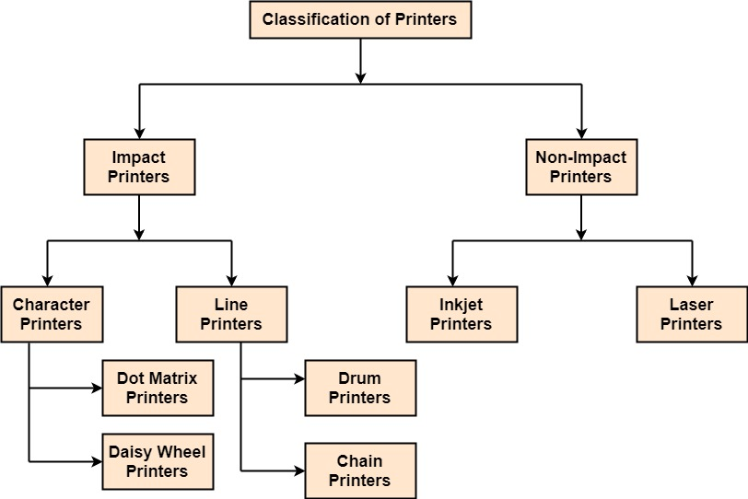
Output Devices Cont…
Printers:
A printer is a peripheral device which is used to represent the graphics or text on paper. The quality is measured by its resolution. The resolution of any printer is measured in dot per inch (dpi).

Slide 77
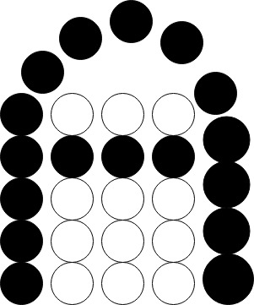
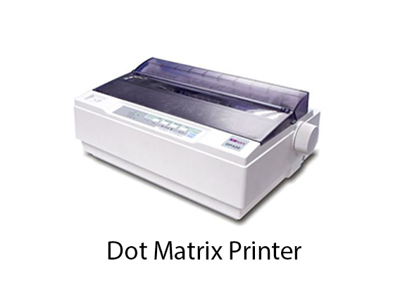
Output Devices Cont…
1. Dot Matrix Printers:
Dot matrix has printed in the form of dots. A printer has a head which contains nine pins. The nine pins are arranged one below other. Each pin can be activated independently. All or only the same needles are activated at a time. When needless is not activated, and then the tip of needle stay in the head. When pin work, it comes out of the print head. In nine pin printer, pins are arranged in 5 * 7 matrixes.
Advantages:
Low Printing Cost
Large print size
Long Life
Disadvantages:
Slow speed
Low Resolution

Slide 78
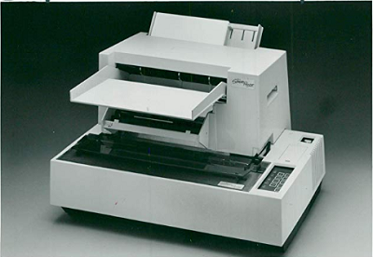
Output Devices Cont…
2. Daisy printer :- By these, we can print only one character at a time. The head of this printer looks like a daisy flower, with the printing arms that appear like petals of a flower; that’s why it is called “Daisy printer.”
It can print approx. 90 characters per second.
Daisy wheel printers are used to print the professional quality document. It is also called “Letter Quality Printer.”
Advantages:
More reliable
Better printing Quality
Disadvantages:
Slow than Dot Matrix
More Expensive
Noisy in operation

Slide 79
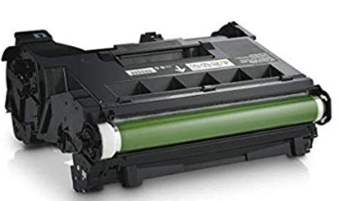
Output Devices Cont…
3. Drum Printers:- It has a shape like a drum, so it is called “Drum Printer.” This type of printer contains many characters that are printed on the drum.
The surface of the drum is break down into the number of tracks. Total tracks are equal to character132. A drum will have 132 tracks. The number of tracks is divided according to the width of the paper.It can print approx. 150-2500 lines per minute.
Advantages:
High Speed
Low Cost
Disadvantages:
Poor Printing Quality
Noisy in Operation

Slide 80

Output Devices Cont…
Non-impact Printers:- In Non-impact printers, there is no physical contact between the print head or paper head. A non-impact printer prints a complete page at a time. The Non-impact printers spray ink on the paper through nozzles to form the letters and patterns.
1. Inkjet Printer: It is also called “Deskjet Printer.” It is a Non-impact printer in which the letters and graphics are printed by spraying a drop of ink on the paper with nozzle head. A Color inkjet printer has four ink nozzles, sapphire, red, yellow, and black, so it is also called CMYK printer. We can produce any color by using these four colors.
The prints and graphics of this printer are very clear. These printers are generally used for home purposes.
Advantages:
High-Quality Printout
Low noise
High Resolution
Disadvantages:
Less Durability of the print head
Not suitable for high volume printing
Cartridges replacement is expensive

Slide 81

Output Devices Cont…
2. Laser Printer: It is also called “Page Printer” because a laser printer process and store the whole page before printing it. The laser printer is used to produce high-quality images and text. Mostly it is used with personal computers. The laser printers are mostly preferred to print a large amount of content on paper.
Advantages:
High Resolution
High printing Speed
Low printing Cost
Disadvantages:
Costly than an inkjet printer
Larger and heavier than an inkjet printer

Slide 82

Output Devices Cont…
Plotters:- A plotter is a special type of output device. It is used to print large graphs, large designs on a large paper. For Example: Construction maps, engineering drawings, architectural plans, and business charts, etc.
Types of Plotter
1. Flatbed Plotter: In a flatbed plotter, the paper is kept in a stationary position on a table or a tray. A flatbed plotter has more than one pen and a holder. The pen rotates on the paper upside-down and right-left by the using of a motor. Every pen has a different color ink, which is used to draw the multicolor design. We can quickly draw the following designs by using a flatbed printer.
For Example: Cars, Ships, Airplanes, Dress design, road and highway blueprints, etc.
Advantages of Flatbed Plotter
Larger size paper can be used
Drawing Quality is similar to an expert
Disadvantages of Flatbed Plotter
Slower than printers
More Expensive than printers
Do not produce high-Quality text printouts

Slide 83

Output Devices Cont…
2. Drum Plotter: It is also called “Roller plotter.” There is a drum in this plotter. We can apply the paper on the drum. When the plotter works, these drums moves back and forth, and the image is drawn.
Drum plotter has more than one pen and penholders. The pens easily moves right to left and left to right.
The movement of pens and drums are controlled by graph plotting program.
It is used in industry to produce large drawings (up to A0).
Advantages of Drum Plotter
Draw Larger Size image
We can print unlimited length of the image
Disadvantages of Drum Plotter
Very costly

Slide 84

Output Devices Cont…
Monitors:- commonly called as Visual Display Unit (VDU), are the main output device of a computer. It forms images from tiny dots, called pixels that are arranged in a rectangular form. The sharpness of the image depends upon the number of pixels.
There are two kinds of viewing screen used for monitors.
Cathode-Ray Tube (CRT)
Flat-Panel Display
1. Cathode-Ray Tube (CRT) Monitor:- The CRT display is made up of small picture elements called pixels. The smaller the pixels, the better the image clarity or resolution. It takes more than one illuminated pixel to form a whole character, such as the letter ‘e’ in the word help.
There are some disadvantages of CRT −
Large in Size
High power consumption

Slide 85

Output Devices Cont…
2. Flat-Panel Display Monitor:- The flat-panel display refers to a class of video devices that have reduced volume, weight and power requirement in comparison to the CRT. You can hang them on walls or wear them on your wrists. Current uses of flat-panel displays include calculators, video games, monitors, laptop computer, and graphics display.
The flat-panel display is divided into two categories −
Emissive Displays − Emissive displays are devices that convert electrical energy into light. For example, plasma panel and LED (Light-Emitting Diodes).
Non-Emissive Displays − Non-emissive displays use optical effects to convert sunlight or light from some other source into graphics patterns. For example, LCD (Liquid-Crystal Device).

Slide 86

Output Devices Cont…
Projector:- A projector is an output device that enables the user to project the output onto a large surface such as a big screen or wall. It can be connected to a computer and similar devices to project their output onto a screen. It uses light and lenses to produce magnified texts, images, and videos. So, it is an ideal output device to give presentations or to teach a large number of people.
Liquid Crystal Display (LCD) digital projector: This type of digital projectors are very popular as they are lightweight and provide crisp output. An LCD projector uses transmissive technology to produce output. It allows the light source, which is a standard lamp, to pass through the three colored liquid crystal light panels. Some colors pass through the panels and some are blocked by the panels and thus images are on the screen.
Digital Light Processing (DLP) digital projector: It has a set of tiny mirrors, a separate mirror for each pixel of the image and thus provide high-quality images. These projectors are mostly used in theatres as they fulfill the requirement of high-quality video output.

Slide 87
Graphics System
A computer graphics system is a computer system which must have all the components of a general-purpose computer system.
six major elements in the Graphics system:
Input devices
Central Processing Unit
Graphics Processing Unit
Memory
Frame buffer
Output devices

Slide 88


Slide 89
Graphics System
Graphics Processor:- A graphics processing unit (GPU) is a computer chip that renders graphics and images by performing rapid mathematical calculations. GPUs are used for both professional and personal computing

Slide 90

Frame Buffer:- A graphics processing unit (GPU) is a computer chip that renders graphics and images by performing rapid mathematical calculations. GPUs are used for both professional and personal computing

Slide 91



Frame buffer

Slide 92




Display Devices(output devices)
The display device is an output device used to represent the information in the form of images (visual form). Display systems are mostly called a video monitor or Video display unit (VDU). Display devices are designed to model, display and view information.

Slide 93




Types of Video Display Devices Available
Cathode Ray Tube Monitors
Flat Panel Displays
Three Dimensional Viewing Devices
Stereoscopic and virtual reality systems

Slide 94


Terminology related to display devices
Pixel : A pixel or the picture element is the smallest item of information in an image. Graphic monitors display pictures by dividing the display screen into thousands of pixels arranged in rows and columns. Each image is made up of thousands of small pixels.

Slide 95

pixel

Slide 96

pixel

Slide 97

Pixel
A pixel is also known as a picture element
(pix = picture, el = element)

Slide 98

Terminology related to display devices
Resolution : (No of pixels on the screen).Resolution is the number of distinct pixels in each dimension that can be displayed. More the resolution more clear is the image .
Example:- screen that has a resolution of 3840 x 2160 it can display 2160 pixels vertically, and 3840 pixels horizontally.

Slide 99
Maximum resolution
1280 x 720 - HD / 720p.
1920 x 1080 - FHD (Full HD) / 1080p.
2560 x 1440 - QHD/WQHD (Quad HD) / 1440p.
3840 x 2160 - UHD (Ultra HD) / 4K 2160p.
7680×4320 - FUHD (Full Ultra HD) / 8K 4320p.

Slide 100
Terminology related to display devices
Aspect ratio of the image is the ratio of the number of X pixels(width) to the number of Y pixels(height).
The standard aspect ratio for a PC is 4:3
Example
Width =720 and height =480
Aspect ratio = width/height
= 720/480
= 1.5
=1:5

Slide 101

Terminology related to display devices
Refresh Rate can be defined as the number of times the screen is refreshed per second
A display appears stable if the refresh rate is high enough, but if the refresh rate is too low, the display will flicker, causing eye strain and headaches.
Refreshing on raster scan displays is carried out at the rate of 60 to 80 frames/sec
Persistence how long phosphor continue to emit light after the CRT beam is removed.

Slide 102
Display Devices(output devices)
The primary output device in a graphics system is a video monitor. The operation of video monitor is based on the standard Cathode Ray Tube(CRT) Design.

Slide 103

Cathode Ray Tube
It is a technology which is used in traditional computer monitor and television. Cathode ray tube is a particular type of vacuum tube that displays images when an electron beam collides on the radiant surface.

Slide 104
Component of CRT
Electron Gun: The electron gun is made up of several elements, mainly a heating filament (heater) and a cathode. The electron gun is a source of electrons focused on a narrow beam facing the CRT.
Focusing & Accelerating Anodes: These anodes are used to produce a narrow and sharply focused beam of electrons.
Horizontal & Vertical Deflection Plates: These plates are used to guide the path of the electron the beam. The plates produce an electromagnetic field that bends the electron beam through the area as it travels.
Phosphorus-coated Screen: The phosphorus coated screen is used to produce bright spots when the high-velocity electron beam hits it.
control grid (which controls the intensity of electrons).

Slide 105

Working of a Cathode Ray Tube

Slide 106

Working of a Cathode Ray Tube

Slide 107
Principle behind Basic Working
The primary components of electron gun are heated metal cathode and control grid (which controls the intensity of electrons).
Heat is supplied to the filament and hence the electrons start boiling.
In the vacuum inside the monitor these electrons are accelerated (by the accelerating anode or by the positive metal coating near the phosphor screen) towards the phosphor coating by a high positive voltage.
Focusing system in CRT forces the electron beam to converge into a small spot as it strikes the phosphor.
Deflection of the electron beam can be controlled either by the electric field or by the magnetic field.

Slide 108
Color CRT
CRT Monitor Displays color pictures by using a combination of phosphors that emit different colored light. The basic idea behind the color CRT monitor is to combine three basic colors- Red, Green, and Blue. By using these three colors, we can produce millions of different colors.
Two Techniques for producing color Display with a CRT are:-
Beam- Penetration
Shadow Mask

Slide 109
Beam Penetration Method
Used with random-scan monitors these systems have Two layers of phosphor, green layer and red one, are coated on to the inside of the CRT screen.
The displayed color depends on how far the electron beam penetrates into the phosphor layers.

Slide 110

A powerful electron beam penetrates the CRT, it passes through the red layer and excites the green layer within.
A beam with slow electrons excites only the red layer.
A beam with the medium speed of electrons, a mixture of red and green light is emitted to display two more colors- orange and yellow.

Slide 111
Beam Penetration Method
It produces a limited number of colors red, orange, yellow and green.
Inexpensive way of producing colors in Random Scan
Picture Quality is not very good.

Slide 112
Shadow Mask Method
Commonly used in raster scan systems
It can display a much wider range than Beam Penetration Method
It has three phosphor color dots (red, green and blue) at each pixel position.
These systems have three electron guns. One for each color dot.
As per the picture definition the electron guns passes the electron beam which is properly deflected through the Shadow Mask grid hence forming a single beam.

Slide 113

Shadow Mask Method
When the beam passes through the Shadow mask. It activates the dot triangle. The phosphor dot triangle are so arranged that it activates it’s corresponding color dot when passes through the shadow mask

Slide 114
Shadow-Mask Method:
Advantage:
Realistic image
Million different colors to be generated
Shadow scenes are possible
Disadvantage:
Relatively expensive compared with the monochrome CRT.
Relatively poor resolution
Convergence Problem

Slide 115

CRT Monitor Technology
RASTER
SCAN DISPLAYS
RANDOM
SCAN DISPLAYS

Slide 116

Raster Scan Display(Character)
Based on television technology , in these the electron beam sweeps across the screen one row at a time from top to bottom.
As the electron beam sweeps the intensity is turned on or off as per the picture definition stored in the frame buffer to create a pattern of illuminated spots.

Slide 117

Raster Scan Display

Slide 118

Raster Scan Display
The beam refreshing has two types:
Horizontal Retracing
Vertical Retracing
When the beam starts from the top left corner and reaches right corner and again return to left corner,- Horizontal Retrace
When the beam starts from the top left corner and reaches bottom right, and again return to the top left, it is called the Vertical Retrace.

Slide 119

Random Scan Displays (also known as Stroke-writing, Vector Or Calligraphic Displays)
When operated as random scan display unit, CRT has electron beam directed only to the parts of the screen where the picture is to be drawn.
These system are used for line drawing (produces smooth line drawings) applications and cannot display realistic shaded scenes.

Slide 120

Random scan display

Slide 121
Random Scan Vs. Raster Scan
Random Scan | Raster Scan
1. It has high Resolution | 1. Its resolution is low.
2. It is more expensive | 2. It is less expensive
3. Any modification if needed is easy | 3.Modification is tough
4. Solid pattern is tough to fill | 4.Solid pattern is easy to fill
5. Refresh rate depends or resolution | 5. Refresh rate does not depend on the picture.
6. Only screen with view on an area is displayed. | 6. Whole screen is scanned.
7. Beam Penetration technology come under it. | 7. Shadow mask technology came under this.
8. It does not use interlacing method. | 8. It uses interlacing
9. It is restricted to line drawing applications | 9. It is suitable for realistic display.

Slide 122
CRT Display : Advantages
Resolution and Aspect Ratio Operate at any resolution, geometry and aspect ratio without the need for rescaling the image.
Highest Resolutions run at the highest pixel resolutions generally available.
Black-Level and Contrast Produce a very dark black and the highest contrast levels normally available.

Slide 123
CRT Display : Advantages
Color and Gray-Scale Accuracy Produces the very best color and gray-scale with an
infinite number of intensity levels.
Motion Artifacts Have fast response times and no motion artifacts so best
for rapidly changing images.
Cost Less expensive than other display technologies.

Slide 124
CRT Display : Disadvantages
Sharpness not as sharp as an LCD at its native resolution.
Geometric Distortion affected by magnetic fields from other equipment including other CRTs.
Brightness Not suitable for very brightly lit environments.
Physical They are large, heavy, and bulky and consume a lot of electricity and produce a lot of heat.

Slide 125
Direct View Storage Tube
In all the earlier technologies we need refreshing of the screen.

Slide 126
Direct View Storage Tube
An alternative method is Direct View Storage Tube .It stores the picture information as a charge distribution just behind the phosphor coated screen.
Two electron guns primary gun and flood gun are used
Primary gun stores the picture pattern and flood gun maintains the picture display

Slide 127
Direct View Storage Tube (DVST):
DVST gives alternative method for maintaining the screen image.
It is used to store the picture information as a charge distribution behind the phosphor-coated screen.
There are two guns used in DVST:
Primary Gun: It is used to store the picture information.
Flood / Secondary Gun: It is used to display a picture on the screen.

Slide 128

Direct-view storage tubes (DVST)

Slide 129
DVST uses the storage grid which stores the picture information as a charge distribution just behind the phosphor coated screen.
A primary gun emits high speed electrons which strike on the storage grid to draw the picture pattern.
As electron beam strikes on the storage grid with high speed, it knocks out electrons from the storage grid keeping the net positive charge.
The knocked out electrons are attracted towards the collector.
The net positive charge on the storage grid is nothing but the picture pattern.
The continuous low speed electrons from flood gun pass through the control grid and are attracted to the positive charged area of the storage grid.

Slide 130

DVST
FLOOD GUN
PRIMARY GUN

Slide 131

DVST Vs Refresh CRT
In DVST since no refreshing required so complex pictures can be displayed at higher resolution without flicker.
However DVST ordinarily does not display colors and parts of image cannot be erased here so not good for animation

Slide 132
Advantages:
Less Time Consuming
No Refreshing Required
High-Resolution
Less Cost
Disadvantages:
The specific part of the image cannot be erased.
They do not display color.

Slide 133
Flat Panel Display
The Flat-Panel display refers to a class of video devices that have reduced volume, weight and power requirement compare to CRT.
Example: Small T.V. monitor, calculator, pocket video games, laptop computers, an advertisement board in elevator.

Slide 134

Flat panel display

Slide 135
Flat panel display
Emissive Display: The emissive displays are devices that convert electrical energy into light.
Example:-
Plasma Panel
Thin film electroluminescent display
LED (Light Emitting Diodes).

Slide 136
Flat panel display
2. Non-Emissive Display: The Non-Emissive displays use optical effects to convert sunlight or light from some other source into graphics patterns.
Examples:-
LCD (Liquid Crystal Device).

Slide 137
advantages
Flat Panel Devices like LCD produces high quality digital images.
Flat Panel monitor are stylish and have very space saving design.
Flat Panel Devices consumes less power and give maximum image size in minimum space.
Flat Panel Devices use its full color display capability.
Full motion video can be viewed on Flat Panel Devices without artifacts or contrast loss.

Slide 138

Plasma Display: It is a type of flat panel display which uses tiny plasma cells. It is also known as the Gas-Discharge display.
Components of Plasma display
Anode: It is used to deliver a positive voltage. It also has the line wires.
Cathode: It is used to provide negative voltage to gas cells. It also has fine wires.
Gas Plates: These plates work as capacitors. When we pass the voltage, the cell lights regularly.
Fluorescent cells: It contains small pockets of gas liquids when the voltage is passed to this neon gas. It emits light.

Slide 139
Advantages
Excellent brightness: Because plasma displays use the direct lighting of they can have an extremely bright and crisp picture. High resolution: Most plasmas these days are at least 720p capable and many are 1080p capable.
PC monitor-capable: Most plasma displays can be plugged directly into any PC to act as a gigantic PC monitor.
Progressive by nature: Plasma systems don’t use a scanning electron beam to create a picture.
A wide viewing angle: Plasma displays have a good picture even when you are sitting “off axis”. In a smaller room, where some of the seating might be at an acute angle from the screen, the wide viewing angle can be a big plus.

Slide 140
Disadvantages
Susceptible to burn-in: Any system that uses a phosphor screen to display video can fall victim to phosphor burn-in.
Poor reproduction of black: Like LCDs, plasma displays have a hard time reproducing black, so black scenes end up being reproduced as shades of gray.

Slide 141



Slide 142


Slide 143


Slide 144


Slide 145


Slide 146


Slide 147


Slide 148


Slide 149


Slide 150


Slide 151
UNIT 1
Introduction to Raster Scan Displays, Pixels, Frame Buffer, Vector & Character Generation, Random Scan Systems, Display Devices, Scan Conversion Techniques, Line Drawing: Simple DDA, Bresenham’s Algorithm, Circle Drawing Algorithms: Midpoint Circle Drawing and Bresenham’s Algorithm, Polygon Fill Algorithm: Boundary-Fill and Flood-Fill Algorithms.

Slide 152
Scan Conversion Techniques
The process of representing continuous graphics object as a collection of discrete pixels is known as scan conversion.
Conversion of every primitive object represented on the graphics screen into a set of pixels that is its basic form is termed as scan conversion or rasterization.

Slide 153
Scan Conversion Algorithms
Scan Conversion of Point
Scan Conversion of Line
Scan Conversion of Circle
Scan Conversion of Ellipse
Scan Conversion of Polygons

Slide 154

Scan Converting a Point
A pixel (10, 6)
Y
X
X
Y
MODELLING CO-ORDINATES
Mathematically vectors are defined in an infinite, “real-number” Cartesian co-ordinate system
SCREEN COORDINATES

Slide 155
Scan Conversion Algorithms
Scan Conversion of Point
Scan Conversion of Line
Scan Conversion of Circle
Scan Conversion of Ellipse
Scan Conversion of Polygons

Slide 156

Line Drawing Algorithms
A line in Computer graphics typically refers to line segment, which is a portion of straight line that extends indefinite
The Line drawing algorithm is a graphical algorithm which is used to represent the line segment on discrete graphical media, opposite direction of starting points.

Slide 157


Scan Converting a Line
How does a machine draw Lines?
Give it a start and end position.
Figure out which pixels to colour in between these…
How do we do this?
Line-Drawing Algorithms: DDA, Bresenham’s Algorithm

Slide 158

Line Drawing Algorithms

Slide 159
Properties of a Line Drawing Algorithm
An algorithm should be precise:
Finiteness:
Easy to understand:
Correctness:
Effectiveness:
Uniqueness:
Input:
Output:

Slide 160

Line drawing
1. Line is defined by its two end points.
Starting points(X1,Y1)
Ending points(X2,Y2)
2. And slope intercept equation
y = mx + c
Where m is slope of line and
c is y intercept of line
C = y-mx

Slide 161
Line drawing Cont…
Slope calculation
Δy = y2-y1
Δx = x2-x1
M = y2-y1/x2-x1 or m = Δy/ Δx

Slide 162

Line drawing Cont…
Types Of Algorithms:

Slide 163

DDA Algorithm
Digital Differential Analyser is an
an algorithm for scan-converting lines
The original differential analyzer
was a physical machine developed by Vannevar Bush at MIT in the 1930’s in order to solve ordinary differential equations.

Slide 164
DDA Line Drawing Algorithm
The Digital Differential Analyzer helps us to interpolate the variables on an interval from one point to another point. We can use the digital Differential Analyzer algorithm to perform rasterization on polygons, lines, and triangles.
Digital Differential Analyzer algorithm is also known as an incremental method of scan conversion. In this algorithm, we can perform the calculation in a step by step manner. We use the previous step result in the next step.

Slide 165

Dda algorithm cont..
As we know the general equation of the straight line is:
y = mx + c
Here, m is the slope of (x₁, y₁) and (x₂, y₂).
m = (y₂ – y₁)/ (x₂ – x₁)
Now, we consider one point (x_{k}, y_{k}) and (x_{k+1}, y_{k+1}) as the next point.

Slide 166
Dda algorithm cont..
Then the slope m = (y_{k+1} – y_{k})/ (x_{k+1} – x_{k})
Now, we have to find the slope between the starting point and ending point. There can be following three cases to discuss:

Slide 167
Dda algorithm cont..
Find the number of steps or points in between the starting and ending coordinates.
if (absolute (ΔX) > absolute (ΔY))
Steps = absolute (ΔX);
else
Steps = absolute (ΔY);
Example
Starting Point = (x₁, y₁) = (0,0)
Ending Point = (x₂, y₂) = (4,6)
Δ x = x₂ – x₁ = 4-0 = 4
Δ y = y₂ – y₁ = 6-0 = 6
Δ x < Δ y = 4<6
So that length = Δ y =6

Slide 168
Dda algorithm cont..
Case 1: If m < 1
Then x coordinate tends to the Unit interval.
x_{k+1} = x_{k} + 1
y_{k+1} = y_{k} + m
Case 2: If m > 1
Then y coordinate tends to the Unit interval.
y_{k+1} = y_{k} + 1
x_{k+1} = x_{k} + 1/m
Case 3: If m = 1
Then x and y coordinate tend to the Unit interval.
x_{k+1} = x_{k} + 1
y_{k+1} = y_{k} + 1

Slide 169
Algorithm of DDA Line Drawing
Step 1: Start.
Step 2: We consider Starting point as (x₁, y₁), and ending point (x₂, y₂).
Step 3: Now, we have to calculate Δ x and Δ y and m.
Δx = x₂-x₁
Δ y = y₂-y₁
m = Δ y/ Δ x
Step 4: Now, we calculate three cases.
1. Case 1: If m < 1
Then x coordinate tends to the Unit interval.
x_{k+1} = x_{k} + 1
y_{k+1} = y_{k} + m
2. Case 2: If m > 1
Then y coordinate tends to the Unit interval.
y_{k+1} = y_{k} + 1
x_{k+1} = x_{k} + 1/m
3. Case 3: If m = 1
Then x and y coordinate tend to the Unit interval.
x_{k+1} = x_{k} + 1
y_{k+1} = y_{k} + 1
Step 5: We will repeat step 4 until we find the ending point of the line.
Step 6: Stop.

Slide 170
Dda algorithm example
Example 1: A line has a starting point (1,7) and ending point (11,17). Apply the Digital Differential Analyzer algorithm to plot a line.
Solution: We have two coordinates,
Starting Point = (x₁, y₁) = (1,7)
Ending Point = (x₂, y₂) = (11,17)

Slide 171
DDA algorithm example
Step 1: First, we calculate Δx, Δ y and m.
Δ x = x₂ – x₁ = 11-1 = 10
Δ y = y₂ – y₁ = 17-7 = 10
m = Δ y/ Δ x = 10/10 = 1
Step 2: Now, we calculate the number of steps.
Δ x = Δ y = 10
Then, the number of steps = 10
Step 3: We get m = 1, Third case is satisfied.
Now move to next step.

Slide 172
Dda algorithm example
case 3: if m=1 then
x_{k+1} = x_{k} + 1
= 1+1
=2
y_{k+1} = y_{k} + 1
=7+1
=8
Then next points for x and y are(2,8).
Now value x_{k} is 2 and y_{k} is 8.

Slide 173
Dda algorithm example
2. x_{k} is 2 and y_{k} is 8
x_{k+1} = x_{k} + 1
= 2+1
=3
y_{k+1} = y_{k} + 1
=8+1
=9
Then next points for x and y are(3,9).
Now value x_{k} is 3 and y_{k} is 9.

Slide 174
Dda algorithm example
x_{k+1} = x_{k} + 1 = 2+1 =3 y_{k+1} = y_{k} + 1 =8+1 =9 New points (3,9 ) | x_{k+1} = x_{k} + 1 = 3+1 =4 y_{k+1} = y_{k} + 1 =9+1 =10 New points (4,11) | x_{k+1} = x_{k} + 1 = 4+1 =5 y_{k+1} = y_{k} + 1 =10+1 =11 New points ( 5,11) | x_{k+1} = x_{k} + 1 = 5+1 =6 y_{k+1} = y_{k} + 1 =11+1 =12 New points (6,12) | x_{k+1} = x_{k} + 1 = 6+1 =7 y_{k+1} = y_{k} + 1 =12+1 =13 New points (7,13)
x_{k+1} = x_{k} + 1 = 7+1 =8 y_{k+1} = y_{k} + 1 =13+1 =14 New points (8,14 ) | x_{k+1} = x_{k} + 1 = 8+1 =9 y_{k+1} = y_{k} + 1 =14+1 =15 New points (9,15 ) | x_{k+1} = x_{k} + 1 = 9+1 =10 y_{k+1} = y_{k} + 1 =15+1 =16 New points (10,16 ) | x_{k+1} = x_{k} + 1 = 10+1 =11 y_{k+1} = y_{k} + 1 =16+1 =17 New points (11,17 )

Slide 175
Dda algorithm example
Step 4: We will repeat step 3 until we get the endpoints of the line.
Step 5: Stop.

Slide 176
Dda algorithm example
x_{k} | y_{k} | x_{k+1} | y_{k+1} | (x_{k+1}, y_{k+1})
1 | 7 | 2 | 8 | (2, 8)
 |  | 3 | 9 | (3, 9)
 |  | 4 | 10 | (4, 10)
 |  | 5 | 11 | (5, 11)
 |  | 6 | 12 | (6, 12)
 |  | 7 | 13 | (7, 13)
 |  | 8 | 14 | (8, 14)
 |  | 9 | 15 | (9, 15)
 |  | 10 | 16 | (10, 16)
 |  | 11 | 17 | (11, 17)

Slide 177

Dda algorithm example

Slide 178
Dda algorithm cont..
Advantages of Digital Differential Analyze
It is a faster method than method of using direct use of line equation.
This method does not use multiplication theorem.
It allows us to detect the change in the value of x and y ,so plotting of same point twice is not possible.
This method gives overflow indication when a point is repositioned.
It is an easy method because each step involves just two additions.

Slide 179
Dda algorithm cont..
Disadvantages of Digital Differential Analyzer
The floating-point arithmetic implementation of the Digital Differential Analyzer is time-consuming.
The method of round-off is also time-consuming.
Sometimes the point position is not accurate.

Slide 180
Exercise
Draw a line from (1, 1) to( 8, 7) using DDA algorithm.
Draw a line from (0, 0) to( 4, 6) using DDA algorithm.

Slide 181

Bresenham’s Line Algorithm
1. Introduction
One disadvantage of DDA is the ROUNDing part which can be expensive
Developed by Jack Bresenham
at IBM in the early 1960s
One of the earliest algorithms in
computer graphics
The Algorithm is based on essentially
the same principles but is completely
based on integer variables

Slide 182
Bresenham’s Line Algorithm
2. Basic Concept
Find the closest integer coordinates to the actual line path using only integer arithmetic
Candidate for the next pixel position
No division, Efficient comparison, No floating point operations
Specified
Line Path
Specified
Line Path

Slide 183

Bresenham’s line drawing algorithm

Slide 184
Bresenham’s line drawing algorithm
Given-
Starting coordinates = (X₁, Y₁)
Ending coordinates = (X₂, Y₂)
The points generation using Bresenham Line Drawing Algorithm involves the following steps-
Step-01:
Calculate ΔX and ΔY from the given input.
These parameters are calculated as-
ΔX = X₂ – X₁
ΔY =Y₂ – Y₁

Slide 185
Bresenham’s line drawing algorithm
Step-02:
Calculate the decision parameter P_{k}.
It is calculated as-
P_{k} = 2ΔY – ΔX

Slide 186
Bresenham’s line drawing algorithm
Step-03:
Suppose the current point is (X_{k}, Y_{k}) and the next point is (X_{k+1}, Y_{k+1}).
Find the next point depending on the value of decision parameter P_{k}.
Follow the below two cases-

Slide 187

Bresenham’s line drawing algorithm
Step-04:
Keep repeating Step-03 until the end point is reached or number of iterations equals to (ΔX-1) times.

Slide 188
Bresenham’s line drawing algorithm
Calculate the points between the starting coordinates (9, 18) and ending coordinates (14, 22).
Solution-
Starting coordinates = (X₁, Y₁) = (9, 18)
Ending coordinates = (X₂, Y₂) = (14, 22)

Slide 189
Bresenham’s line drawing algorithm
Step-01:
Calculate ΔX and ΔY from the given input.
ΔX = X₂ – X₁ = 14 – 9 = 5
ΔY =Y₂ – Y₁= 22 – 18 = 4
Step-02:
Calculate the decision parameter.
P_{k}= 2ΔY – ΔX
= 2 x 4 – 5
= 3
So, decision parameter P_{k} = 3

Slide 190
Bresenham’s line drawing algorithm
Step-03:
1. As P_{k} >= 0, so case-02 is satisfied.
Thus,
P_{k+1} = P_{k} + 2ΔY – 2ΔX = 3 + (2 x 4) – (2 x 5) = 1
X_{k+1} = X_{k} + 1 = 9 + 1 = 10
Y_{k+1} = Y_{k} + 1 = 18 + 1 = 19
Then next points for x and y are(10,19).
Now value x_{k} is 10 , y_{k} is 19 and P_{k} is 1.

Slide 191
Bresenham’s line drawing algorithm
2. As P_{k} >= 0, so case-02 is satisfied.
Thus,
P_{k+1} = P_{k} + 2ΔY – 2ΔX = 1 + (2 x 4) – (2 x 5) = -1
X_{k+1} = X_{k} + 1 = 10 + 1 = 11
Y_{k+1} = Y_{k} + 1 = 19+ 1 = 20
Then next points for x and y are(11,20).
Now value x_{k} is 11 , y_{k} is 20 and P_{k} is -1.

Slide 192
Bresenham’s line drawing algorithm
3. As P_{k} <0, so case-01 is satisfied.
Thus,
P_{k+1} = P_{k} + 2ΔY = -1 + (2 x 4) = 7
X_{k+1} = X_{k} + 1 = 11 + 1 = 12
Y_{k+1} = Y_{k} = 20 = 20
Then next points for x and y are(12,20).
Now value x_{k} is 12 , y_{k} is 20 and P_{k} is 7.

Slide 193
Bresenham’s line drawing algorithm
4. As P_{k} >= 0, so case-02 is satisfied.
Thus,
P_{k+1} = P_{k} + 2ΔY – 2ΔX = 7 + (2 x 4) – (2 x 5) = 5
X_{k+1} = X_{k} + 1 = 12 + 1 = 13
Y_{k+1} = Y_{k} + 1 = 20+ 1 = 21
Then next points for x and y are(13,21).
Now value x_{k} is 13 , y_{k} is 21 and P_{k} is 5.

Slide 194
Bresenham’s line drawing algorithm
5. As P_{k} >= 0, so case-02 is satisfied.
Thus,
P_{k+1} = P_{k} + 2ΔY – 2ΔX = 5 + (2 x 4) – (2 x 5) = 3
X_{k+1} = X_{k} + 1 = 13 + 1 = 14
Y_{k+1} = Y_{k} + 1 = 21+ 1 = 22
Then next points for x and y are(14,22).

Slide 195
Bresenham’s line drawing algorithm
P_{k} | P_{k+1} | X_{k+1} | Y_{k+1}
 |  | 9 | 18
3 | 1 | 10 | 19
1 | -1 | 11 | 20
-1 | 7 | 12 | 20
7 | 5 | 13 | 21
5 | 3 | 14 | 22

Slide 196

Bresenham’s line drawing algorithm

Slide 197
Bresenham’s Line Algorithm
5. Exercise
Calculate pixel positions that made up the line connecting endpoints: (12, 10) and (17, 14).
1. (x₀, y₀) = ?
2. Δx = ?, Δy =?, 2Δy = ?, 2Δy – 2Δx =?
3. p₀ = 2Δy – Δx =?
k | p_{k} | (x_{k+1}, y_{k+1})

Slide 198
Bresenham’s Line Algorithm
5. Exercise
Calculate pixel positions that made up the line connecting endpoints: (12, 10) and (17, 14).
1. (x₀, y₀) = (12,10)
2. Δx = 5, Δy =4, 2Δy = 8, 2Δy – 2Δx =-2
3. p₀ = 2Δy – Δx =3
k | p_{k} | (x_{k+1}, y_{k+1})
0 | 3
1
2

Slide 199
Bresenham’s Line Algorithm
5. Exercise
Calculate pixel positions that made up the line connecting endpoints: (12, 10) and (17, 14).
1. (x₀, y₀) = (12,10)
2. Δx = 5, Δy =4, 2Δy = 8, 2Δy – 2Δx =-2
3. p₀ = 2Δy – Δx =3
k | p_{k} | (x_{k+1}, y_{k+1})
0 | 3 | (13, 11)
1 | 1 | (14, 12)
2 | -1 | (15, 12)
3 | 7 | (16, 13)
4 | 5 | (17, 14)

Slide 200
Bresenham’s Line Algorithm
5. Exercise: Trace for (20,10) to (30,18)
k | p_{k} | (x_{k+1},y_{k+1})
18
17
16
15
14
13
12
11
10
20
21
22
23
24
25
26
27
28
29
30

Slide 201
Bresenham’s Line Algorithm
Answer
k | p_{k} | (x_{k+1},y_{k+1})
0 1 2 3 4 5 6 7 8 9 | 6 2 -2 14 10 6 2 -2 14 10 | (21,11) (22,12) (23,12) (24,13) (25,14) (26,15) (27,16) (28,16) (29,17) (30,18)
18
17
16
15
14
13
12
11
10
20
21
22
23
24
25
26
27
28
29
30

Slide 202
Bresenham’s line drawing algorithm
Advantages
It is easy to implement.
It is fast and incremental.
The points generated by this algorithm are more accurate than DDA Algorithm.
It uses fixed points only.

Slide 203
Bresenham’s line drawing algorithm
Disadvantages
Though it improves the accuracy of generated points but still the resulted line is not smooth.
This algorithm is for the basic line drawing.

Slide 204
Difference between DDA and Bresenham’s algorithm
S.NO | DDA Line Algorithm | Bresenham line Algorithm
1. | DDA stands for Digital Differential Analyzer. | While it has no full form.
2. | DDA algorithm is less efficient than Bresenham line algorithm. | While it is more efficient than DDA algorithm.
3. | The calculation speed of DDA algorithm is less than Bresenham line algorithm. | While the calculation speed of Bresenham line algorithm is faster than DDA algorithm.
4. | DDA algorithm is costlier than Bresenham line algorithm. | While Bresenham line algorithm is cheaper than DDA algorithm.
5. | DDA algorithm has less precision or accuracy. | While it has more precision or accuracy.
6. | In DDA algorithm, the complexity of calculation is more complex. | While in this, the complexity of calculation is simple.
7. | In DDA algorithm, optimization is not provided. | While in this, optimization is provided.

Slide 205


Circle Drawing Algorithms
A circle is fundamentally symmetric and exhibits octant symmetry. i.e. a circle is symmetric about its octants. The equation of circle is
$$x^{2}+y^{2}=r^{2}$$
where r is radius.

Slide 206

Circle Drawing Algorithms

Slide 207
Mid Point Circle Drawing Algorithm-
If we know a point on any one of the octants the remaining 7 symmetric points can be plotted by interchanging magnitudes of x and y and also signs
As shown in the diagram above, divide the circle into 8 parts (each is an octant) using 4 axes. Assume that we know a point say (x, y) on one of the octants, the remaining 7 symmetric points on the seven octants can be easily plotted without making any computations. If we fold the octants about an axis, the octant exactly overlaps on the neighboring octant due to symmetry.

Slide 208

Mid Point Circle Drawing Algorithm-

Slide 209

Mid Point Circle Drawing Algorithm-
Any point (x, y) on the boundary of the circle with radius r satisfies the equation
x² + y² – r² =0
If the point is inside the circle. Then the circle function is negative. And if the point is outside the circle. Then the circle function is positive.
Firstly, x² + y² – r² < 0it means point(x,y) is inside the circle
Secondly, x² + y² – r² >0it means point(x,y) is outside the circle

Slide 210
Mid Point Circle Drawing Algorithm-
Given the center point and radius of circle,
Mid Point Circle Drawing Algorithm attempts to generate the points of one octant.
Given-
Centre point of Circle = (X₀, Y₀)
Radius of Circle = R

Slide 211
Mid Point Circle Drawing Algorithm-
Step-01:
Assign the starting point coordinates (X₀, Y₀) as-
X₀ = 0
Y₀ = R
Step-02:
Calculate the value of initial decision parameter P₀ as-
P₀ = 1 – R

Slide 212
Mid Point Circle Drawing Algorithm-
Step-03:
Suppose the current point is (X_{k}, Y_{k}) and the next point is (X_{k+1}, Y_{k+1}).
Find the next point of the first octant depending on the value of decision parameter P_{k}.
Follow the below two cases-

Slide 213

Mid Point Circle Drawing Algorithm-

Slide 214
Mid Point Circle Drawing Algorithm-
Step-04:
If the given centre point (X₀, Y₀) is not (0, 0), then do the following and plot the point-
X_{plot} = X_{c} + X₀
Y_{plot} = Y_{c} + Y₀
Here, (X_{c}, Y_{c}) denotes the current value of X and Y coordinates.
Step-05:
Keep repeating Step-03 and Step-04 until X_{plot} >= Y_{plot}.

Slide 215
Mid Point Circle Drawing Algorithm-
Step-06:
Step-05 generates all the points for one octant.
To find the points for other seven octants, follow the eight symmetry property of circle.

Slide 216
example
Given the centre point coordinates (0, 0) and radius as 10, generate all the points to form a circle.
Solution-
Given-
Centre Coordinates of Circle (X₀, Y₀) = (0, 0)
Radius of Circle = 10
Step-01:
Assign the starting point coordinates (X₀, Y₀) as-
X₀ = 0
Y₀ = R = 10

Slide 217
example
Step-02:
Calculate the value of initial decision parameter P₀ as-
P₀ = 1 – R
P₀ = 1 – 10
P₀ = -9
Step-03:
As P_{initial} < 0, so case-01 is satisfied.

Slide 218
example
Thus,
X_{k+1} = X_{k} + 1 = 0 + 1 = 1
Y_{k+1} = Y_{k} = 10
P_{k+1} = P_{k} + 2 x X_{k+1} + 1 = -9 + (2 x 1) + 1 = -6
Now next points for xk is 1,yk is 10 and pk is -6
Step-04:
This step is not applicable here as the given centre point coordinates is (0, 0).

Slide 219
example
Next points are pk = -6 <0 then
Calculate X_{k+1} = X_{k} + 1 = 1+1=2
Y_{k+1} = Y_{k} = 10
P_{k+1} = P_{k} + 2 x X_{k+1} + 1 = -6 + (2 x 2) + 1 = -6+5= -1
Now next points for xk is 2,yk is 10 and pk is -1

Slide 220
example
Next points are pk = -1 <0 then
Calculate X_{k+1} = X_{k} + 1 , 2+1 = 3
Y_{k+1} = Y_{k} = 10
P_{k+1} = P_{k} + 2 x X_{k+1} + 1 = -1+(2*3)+1, = -1+7 = 6
Now next points for xk is 3,yk is 10 and pk is 6

Slide 221
example
Next points are pk = 6 >0 then
X_{k+1} = X_{k} + 1 , 3+1 = 4
Y_{k+1} = Y_{k} -1 , 10-1 = 9
P_{k+1} = P_{k} -2* Y_{k+1} + 2 x*X_{k+1} + 1 =
= 6-(2*9)+ (2*4)+1
=6-18+8+1
=15-18
-3
Now next points for xk is 4,yk is 9and pk is -3

Slide 222
example
Next points are pk = -3 <0 then
Calculate X_{k+1} = X_{k} + 1 , 4+1 = 5
Y_{k+1} = Y_{k} = 9 = 9
P_{k+1} = P_{k} + 2 x X_{k+1} + 1 = -3+(2*5)+1, = -3+11 = 8
Now next points for xk is 5,yk is 9 and pk is 8

Slide 223
example
Next points are pk = 8 >0 then
X_{k+1} = X_{k} + 1 , 5+1 = 6
Y_{k+1} = Y_{k} -1 , 9-1 = 8
P_{k+1} = P_{k} -2* Y_{k+1} + 2 x*X_{k+1} + 1
= 8-(2*8)+ (2*6)+1
=8-16+12+1
=5
Now next points for xk is 6,yk is 8and pk is 5

Slide 224
example
Next points are pk = 5 >0 then
X_{k+1} = X_{k} + 1 , 6+1 = 7
Y_{k+1} = Y_{k} -1 , 8-1 = 7
P_{k+1} = P_{k} -2* Y_{k+1} + 2 x*X_{k+1} + 1
= 5-(2*7)+ (2*7)+1
=5-14+14+1
=6
Now next points for xk is 7,yk is 7and pk is 6

Slide 225
example
P_{k} | P_{k+1} | (X_{k+1}, Y_{k+1})
 |  | (0, 10)
-9 | -6 | (1, 10)
-6 | -1 | (2, 10)
-1 | 6 | (3, 10)
6 | -3 | (4, 9)
-3 | 8 | (5, 9)
8 | 5 | (6, 8)
5 | 6 | (7,7)
Algorithm Terminates These are all points for Octant-1.

Slide 226
Advantages
It is a powerful and efficient algorithm.
The entire algorithm is based on the simple equation of circle X² + Y² = R².
It is easy to implement from the programmer’s perspective.
This algorithm is used to generate curves on raster displays.

Slide 227
disadvantages
Accuracy of the generating points is an issue in this algorithm.
The circle generated by this algorithm is not smooth.
This algorithm is time consuming.

Slide 228
Example 2
Given the center point coordinates (4, 4) and radius as 10, generate all the points to form a circle.
Solution-
Given-
Centre Coordinates of Circle (X₀, Y₀) = (4, 4)
Radius of Circle = 10
We first calculate the points assuming the centre coordinates is (0, 0).

Slide 229
Example 2
Step-01:
Assign the starting point coordinates (X₀, Y₀) as-
X₀ = 0
Y₀ = R = 10

Slide 230
example
Step-02:
Calculate the value of initial decision parameter P₀ as-
P₀ = 1 – R
P₀ = 1 – 10
P₀ = -9
Step-03:
As P_{initial} < 0, so case-01 is satisfied.

Slide 231
example
Thus,
X_{k+1} = X_{k} + 1 = 0 + 1 = 1
Y_{k+1} = Y_{k} = 10
P_{k+1} = P_{k} + 2 x X_{k+1} + 1 = -9 + (2 x 1) + 1 = -6
Now next points for xk is 1,yk is 10 and pk is -6

Slide 232
example
Thus,
X_{k+1} = X_{k} + 1 = 0 + 1 = 1
Y_{k+1} = Y_{k} = 10
P_{k+1} = P_{k} + 2 x X_{k+1} + 1 = -9 + (2 x 1) + 1 = -6
Now next points for xk is 1,yk is 10 and pk is -6

Slide 233
Example 2
Step-04:
we find the values of X_{plot} and Y_{plot} using the formula
X_{plot} = X_{c} + X₀ = 4 + X₀ = 4+0 = 4
Y_{plot} = Y_{c} + Y₀ = 4 + Y₀ = 4+10 = 14

Slide 234

Bresenham Circle Drawing Algorithm-
Given the centre point and radius of circle,
Bresenham Circle Drawing Algorithm attempts to generate the points of one octant.
is a circle drawing algorithm which calculates all the nearest points nearest to the circle boundary. It is an incremental method.
It only uses integer arithmetic which makes it's working faster as well as less complex.
The strategy that is followed in this algorithm is to select the pixel which has the least distance with the true circle boundary and with then keep calculating the successive points on the circle.

Slide 235



Slide 236


Slide 237
Bresenham’s circle drawing algo
Given-
Centre point of Circle = (X₀, Y₀)
Radius of Circle = R
The points generation using Bresenham Circle Drawing Algorithm involves the following steps-
Step-01:
Assign the starting point coordinates (X₀, Y₀) as-
X₀ = 0
Y₀ = R

Slide 238
Bresenham’s circle drawing algo
Step-02:
Calculate the value of initial decision parameter P₀ as-
P₀ = 3 – 2 x R
Step-03:
Suppose the current point is (X_{k}, Y_{k}) and the next point is (X_{k+1}, Y_{k+1}).

Slide 239

Bresenham’s circle drawing algo

Slide 240
Bresenham’s circle drawing algo
Step-04:
If the given centre point (X₀, Y₀) is not (0, 0), then do the following and plot the point-
X_{plot} = X_{c} + X₀
Y_{plot} = Y_{c} + Y₀
Here, (X_{c}, Y_{c}) denotes the current value of X and Y coordinates.
Step-05:
Keep repeating Step-03 and Step-04 until X_{plot} => Y_{plot}.
Step-06:
Step-05 generates all the points for one octant.

Slide 241
example
Problem-01:
Given the centre point coordinates (0, 0) and radius as 8, generate all the points to form a circle.
Solution-
Given-
Centre Coordinates of Circle (X₀, Y₀) = (0, 0)
Radius of Circle = 8

Slide 242
example
Step-01:
Assign the starting point coordinates (X₀, Y₀) as-
X₀ = 0
Y₀ = R = 8
Step-02:
Calculate the value of initial decision parameter P₀ as-
P₀ = 3 – 2 x R
P₀ = 3 – 2 x 8
P₀ = -13

Slide 243
example
Step-03:
1. As P_{initial} < 0, so case-01 is satisfied.
Thus,
X_{k+1} = X_{k} + 1 = 0 + 1 = 1
Y_{k+1} = Y_{k} = 8
P_{k+1} = P_{k} + 4 x X_{k+1} + 6 = -13 + (4 x 1) + 6 = -3
So the next points x X_{k} is 1, Y_{k} is 8 and P_{k} is -3
Step-04:
This step is not applicable here as the given centre point coordinates is (0, 0).

Slide 244
example
As P_{initial} (-3) < 0, so case-01 is satisfied.
Thus,
X_{k+1} = X_{k} + 1 = 1+ 1 = 2
Y_{k+1} = Y_{k} = 8
P_{k+1} = P_{k} + 4 x X_{k+1} + 6 = -3+ (4 x 2) + 6 = 11
So the next points x X_{k} is 2, Y_{k} is 8 and P_{k} is 11

Slide 245
example
As P_{initial} (11) >= 0, so case-02 is satisfied.
Thus,
X_{k+1} = X_{k} + 1 = 2 + 1 = 3
Y_{k+1} = Y_{k} -1 = 8-1 = 7
P_{k+1} = P_{k} + 4 x (X_{k+1} - Y_{k+1} ) + 10 = 11 + 4 (3-7) + 10
= 11+4*(-4)+10
=11-16+10
21-16
= 5
So the next points x X_{k} is 3, Y_{k} is 7 and P_{k} is 5

Slide 246
example
As P_{initial} (5) >= 0, so case-02 is satisfied.
Thus,
X_{k+1} = X_{k} + 1 = 3+1 = 4
Y_{k+1} = Y_{k} -1 = 7- 1 = 6
P_{k+1} = P_{k} + 4 x (X_{k+1} - Y_{k+1} ) + 10 = 5+4(4-6)+10
5+(4*-2)+10
15-8
7
So the next points x X_{k} is 4, Y_{k} is 6 and P_{k} is 7

Slide 247
example
As P_{initial} (7) >= 0, so case-02 is satisfied.
Thus,
X_{k+1} = X_{k} + 1 = 4+1 = 5
Y_{k+1} = Y_{k} -1 = 6-1 = 5
P_{k+1} = P_{k} + 4 x (X_{k+1} - Y_{k+1} ) + 10 = 7+4(5-5)+10
7+(4*0)+10
17+0
17
So the next points x X_{k} is 5, Y_{k} is 5 and P_{k} is 17

Slide 248
example
P_{k} | P_{k+1} | (X_{k+1}, Y_{k+1})
 |  | (0, 8)
-13 | -3 | (1, 8)
-3 | 11 | (2, 8)
11 | 5 | (3, 7)
5 | 7 | (4, 6)
7 | 17 | (5, 5)

Slide 249
advantages
The entire algorithm is based on the simple equation of circle X² + Y² = R².
It is easy to implement.

Slide 250
disadvantage
Like Mid Point Algorithm, accuracy of the generating points is an issue in this algorithm.
This algorithm suffers when used to generate complex and high graphical images.
There is no significant enhancement with respect to performance.

Slide 251


Slide 252


Slide 253

Polygons are of two types as:
Convex Polygon
In convex polygon, none of the interior angles, between the vertices, is greater than or equal to 180°.
Concave Polygon
In concave polygon, at least one angle of a polygon is more than 180°.

Slide 254


CONCAVE POLYGON
CONVEX POLYGON

Slide 255

To determine a point lies inside a polygon or not, in computer graphics, we have two methods :

Slide 256


Slide 257

the line segment from ‘A’ crosses single edge & hence point A is inside the polygon. The point B is also inside the polygon as the line segment from B crosses three (odd) edges. But point C is outside the polygon it as the line segment from C crosses two (even) edges.

Slide 258


Slide 259

We must look at the other end points of the two segments of a polygon which meet at this vertex. If these points lies on the same side of the constructed line A’P’, then the intersection point counts as an even number of intersection. But if they lie on the opposite side of constructed line AP, then the intersection points counts as a single intersection.

Slide 260


Slide 261


Slide 262
In this method, instead of just counting the intersections, we give each boundary line crossed a direction number, and we sum these directions numbers. The direction number indicates the direction of the polygon edge was drawn relative to the line segment we constructed for the test.
Now there are 2 ways for side to cross, the side could be drawn starting below end, cross it and end above the line. In this case we can give direction numbers – 1, to the side or the edge could start above the line & finish below it in this case, given a direction 1. The sum of the direction numbers for the sides that cross the constructed horizontal line segment yield the “Winding Number” for the point.
If the winding number is non-zero , the point is interior to polygon, else, exterior to polygon.

Slide 263

Q
QQ
In the above figure, the line segment crosses 4 edges having different direction numbers : 1, -1, 1& -1 respectively,
then : Winding Number = 1 + (-1) + 1 + (-1) = 0 So the point P is outside the Polygon.

Slide 264


Slide 265


Slide 266


Slide 267


Slide 268


Slide 269


Slide 270


Slide 271





Slide 272




Slide 273


Slide 274





Slide 275




Slide 276



Slide 277


Slide 278


Slide 279



Slide 280


Slide 281


Slide 282


Slide 283


Slide 284
THANK YOU

